Slide 1

Exposys Data Lab
Internship 2021
Full Stack Development
Submitted by -
ASHWIN P M
Krishna Ram
Madhu Manju .S
G. Mugilan
M. Rishikaran

Slide 2

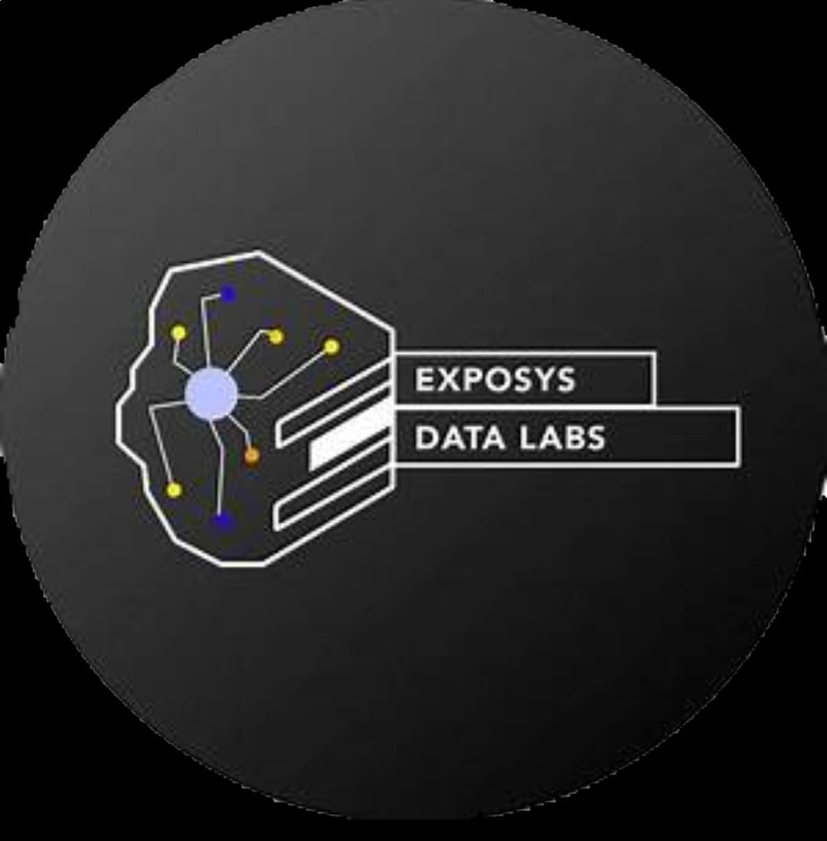
DDOS ATTACK
What is DDOS Attack:
A Denial-of-service attack (DoS attack) is a cyber-attack in which the perpetrator seeks to make a machine or network resource unavailable to its intended users by temporarily or indefinitely disrupting services of a host connected to the Internet. Denial of service is typically accomplished by flooding the targeted machine or resource with superfluous requests in an attempt to overload systems and prevent some or all legitimate requests from being fulfilled.
A DDoS attack occurs when multiple systems flood the bandwidth or resources of a targeted system, usually one or more web servers.A DDoS attack uses more than one unique IP address or machines, often from thousands of hosts infected with malware.A distributed denial of service attack typically involves more than around 3–5 nodes on different networks; fewer nodes may qualify as a DoS attack but is not a DDoS attack.

Slide 3

How does a DDoS attack work:?
DDoS attacks are carried out with networks of Internet-connected machines.
Suspicious amounts of traffic originating from a single IP address or IP range
A flood of traffic from users who share a single behavioral profile, such as device type, geolocation, or web browser version
An unexplained surge in requests to a single page or endpoint
Odd traffic patterns such as spikes at odd hours of the day or patterns that appear to be unnatural (e.g. a spike every 10 minutes)

Slide 4
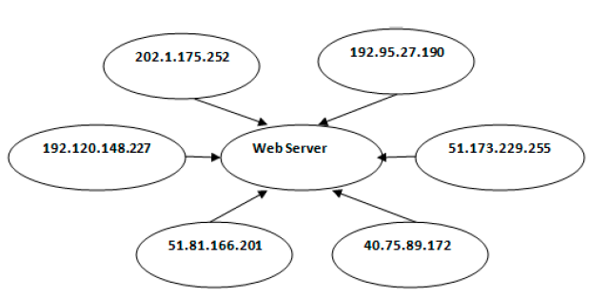
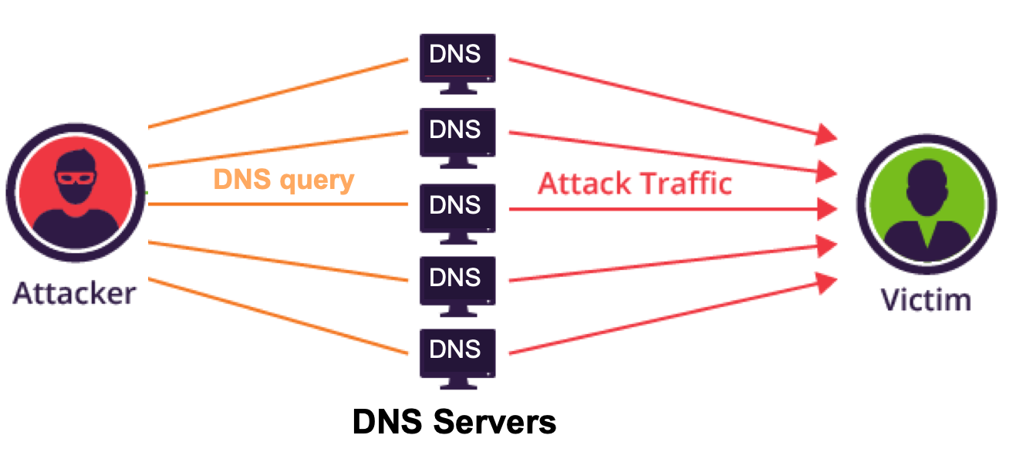
Attack Scenario:

Slide 5
Procedure for attacks:
In our experiment we have used multiple methods to initiate the attacking processes we have used the Slowloris package in the python code
And we have used the kali linux os through virtual box for using METASPLOIT tool and Nmap algorithm for scanning the ports in the host.

Slide 6
Software reguirements:
1.Slowloris
2.Metasploit
3.Nmap
4.Wireshark
5.Pycharm
6.Windows 10 &Kali Linux
Hardware reguirement ::
Processor: i5-i7
Ram : minimum 8GB
Graphics: Nvdia 4gb 1650Ti
1.

Slide 7
Slowloris:
Slowloris is a type of denial of service attack tool which allows a single machine to take down another machine's web server with minimal bandwidth and side effects on unrelated services and ports.
Slowloris tries to keep many connections to the target web server open and hold them open as long as possible. It accomplishes this by opening connections to the target web server and sending a partial request. Periodically, it will send subsequent HTTP headers, adding to, but never completing, the request. Affected servers will keep these connections open, filling their maximum concurrent connection pool, eventually denying additional connection attempts from clients.
The program was named after slow lorises, a group of primates which are known for their slow movement.

Slide 8
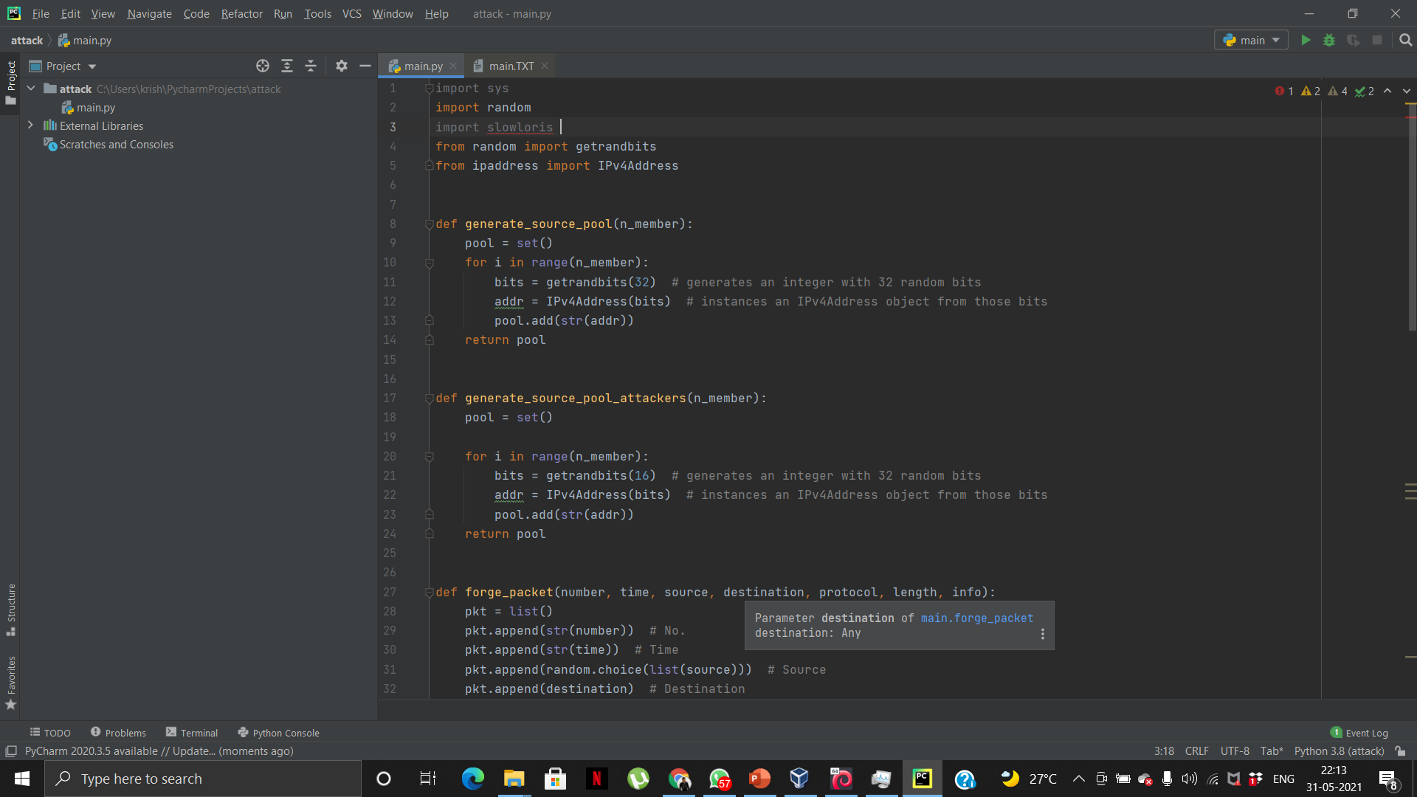
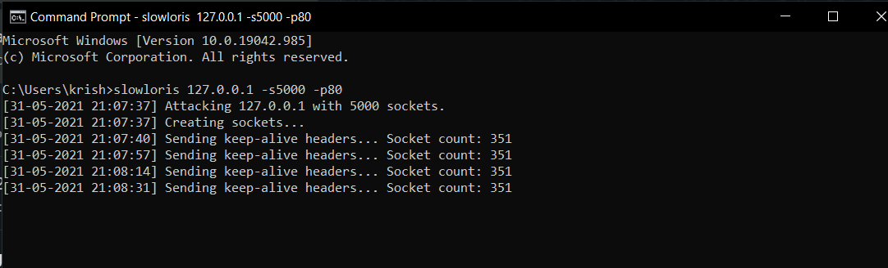
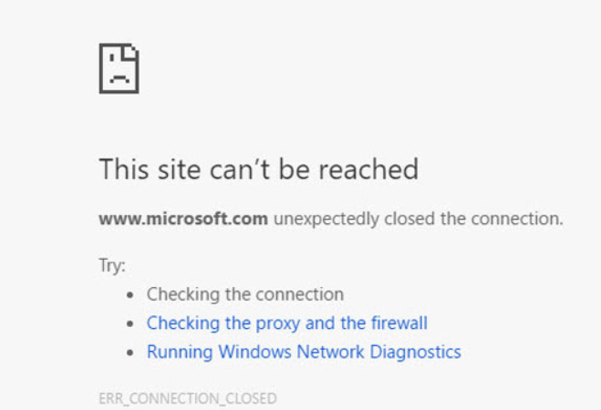
Attack using Slowloris::
Output:
We used the local host XAMPP for testing our code and as we can see, the site crashed after sending the required amount of packets

Slide 9

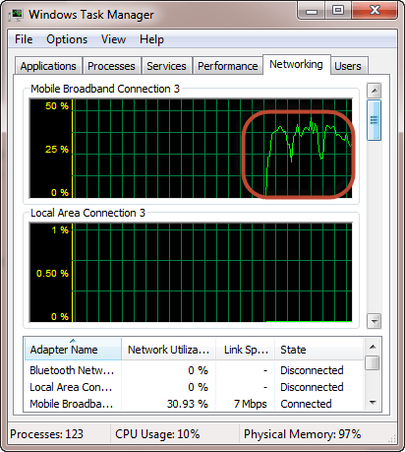
If you want to see the effects of the attack on the target computer, you can open the task manager and view the network activities.
If the attack is successful, you should be able to see increased network activities.

Slide 10
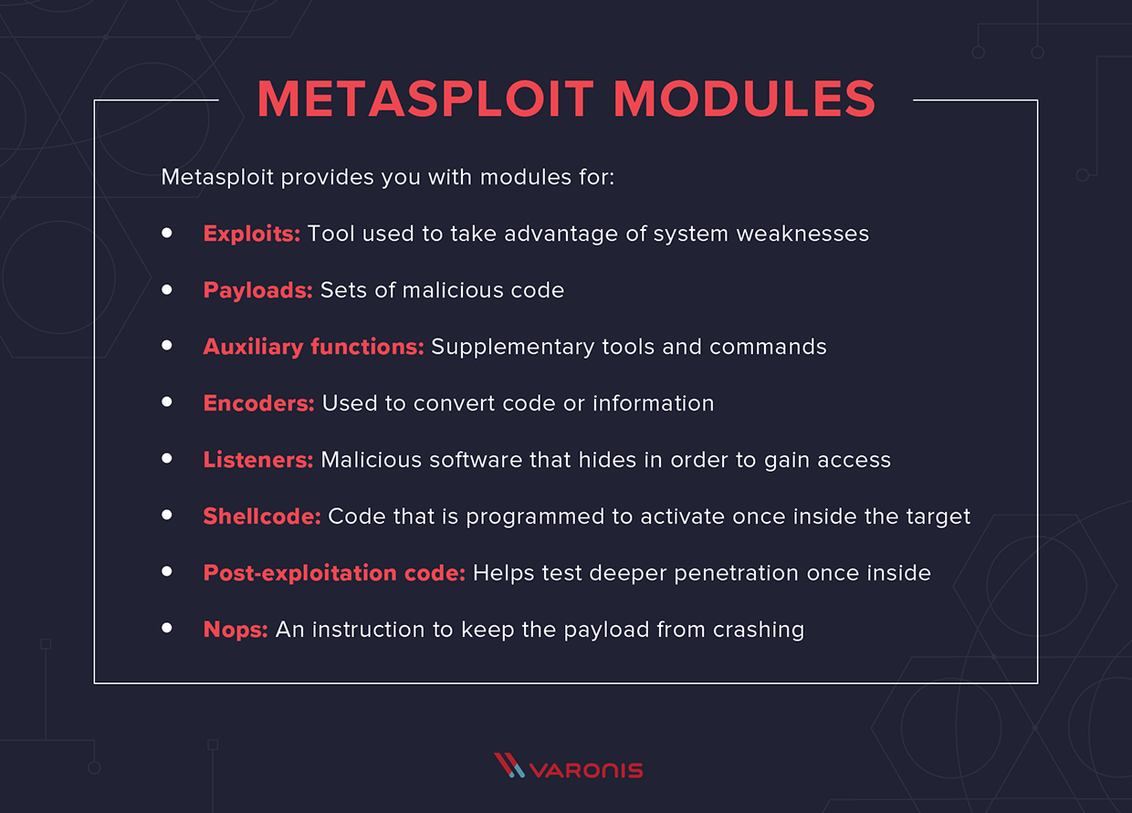
Metasploit:
The Metasploit framework is a very powerful tool which can be used by cybercriminals as well as ethical hackers to probe systematic vulnerabilities on networks and servers. Because it’s an open-source framework, it can be easily customized and used with most operating systems.
With Metasploit, the pen testing team can use ready-made or custom code and introduce it into a network to probe for weak spots. As another flavor of threat hunting, once flaws are identified and documented, the information can be used to address systemic weaknesses and prioritize solutions.

Slide 11
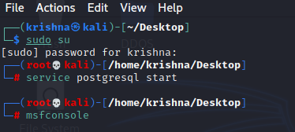
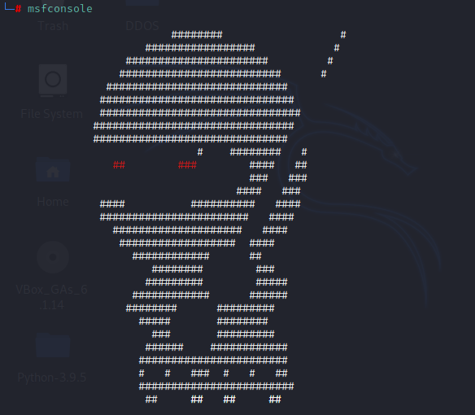
Using Metasploit in Kali Linux

Slide 12
NMAP:
Nmap (Network Mapper) is a free and open-source network scanner created by Gordon Lyon (also known by his pseudonym Fyodor Vaskovich. Nmap is used to discover hosts and services on a computer network by sending packets and analyzing the responses.
Nmap provides a number of features for probing computer networks, including host discovery and service and operating system detection. These features are extensible by scripts that provide more advanced service detection , vulnerability detection, and other features. Nmap can adapt to network conditions including latency and congestion during a scan.
The program can be used to find live hosts on a network, perform port scanning, ping sweeps, OS detection, and version detection.

Slide 13
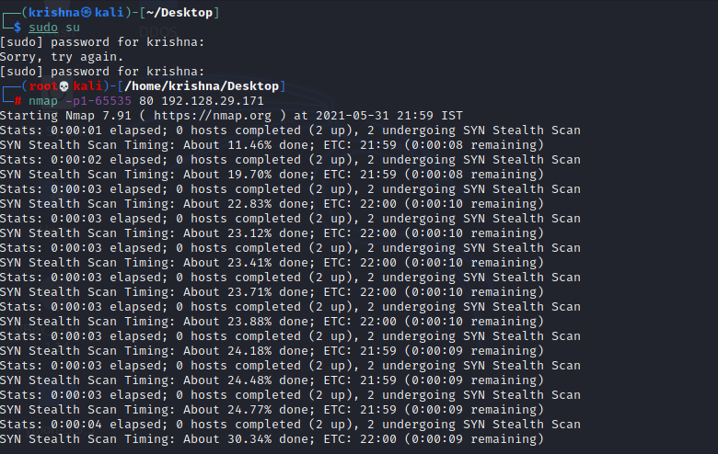
NMAP in LINUX

Slide 14
Detection of DDOS ATTACK:
DDoS detection is the process of distinguishing Distributed Denial of Service (DDoS) attacks from normal network traffic, in order to perform effective attack mitigation. The primary goal of a DDoS attack is to either limit access to an application or network service, thereby denying legitimate users access to the services.
There are many types of DDoS attack schemes that are used today and they are steadily becoming more sophisticated. However, their common goal is to overwhelm targeted network resources with traffic or requests for service from many different sources – potentially hundreds of thousands or more.

Slide 15
Effects of DDOS ATTACK:
When a server is attacked by DDoS, it slowly starts killing it’s performance. The first thing you will notice after the attack is server crashing. The server makes all the service unavailable & shows a 503 error i.e. “ Service Unavailable”. Heavy DDoS attack may cause permanent 503 server reply to all the users.
The next thing you will notice is the server wont crash completely but all the services in the servers become very slow for production. Sometimes it takes several minutes to deposit a form or render a page. If you have a doubt that you might be a victim of this attack then use NetStat present in all Windows operating system.
For this all you need to do is open a Windows command Prompt & then type “netstat –an”. This will generate standard output. If yes then your server is fine and if see different IP addresses linked with some particular port, then get ready your server was attacked by DDoS attack.
We cannot ignore the fact that internet has become an important part of our life,so it is our responsibility to use it safely, protect it from all types of malwares and vulnerable threats that would ultimately harm it & make us loose all our important sensitive data

Slide 16
Wireshark:
Wireshark is a free and open-source packet analyzer. It is used for network troubleshooting, analysis, software and communications protocol development, and education. Originally named Ethereal, the project was renamed Wireshark in May 2006 due to trademark issues.
Wireshark is cross-platform, using the Qt widget toolkit in current releases to implement its user interface, and using pcap to capture packets; it runs on Linux, macOS, BSD, Solaris, some other Unix-like operating systems, and Microsoft Windows.
Functionality:
Wireshark is very similar to tcpdump, but has a graphical front-end and integrated sorting and filtering options.
Wireshark lets the user put network interface controllers into promiscuous mode (if supported by the network interface controller), so they can see all the traffic visible on that interface including unicast traffic not sent to that network interface controller's MAC address.

Slide 17
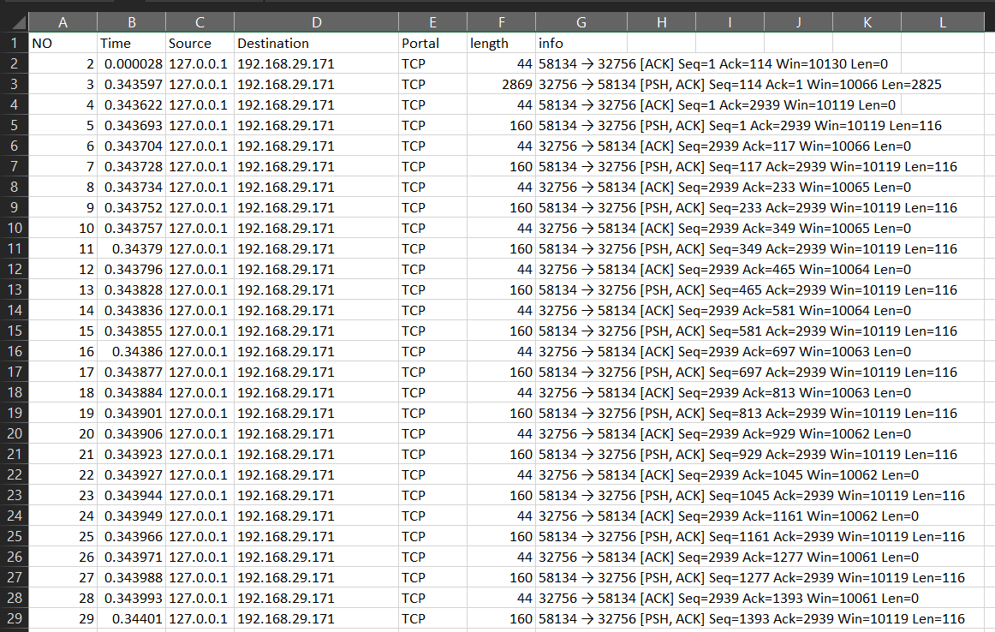
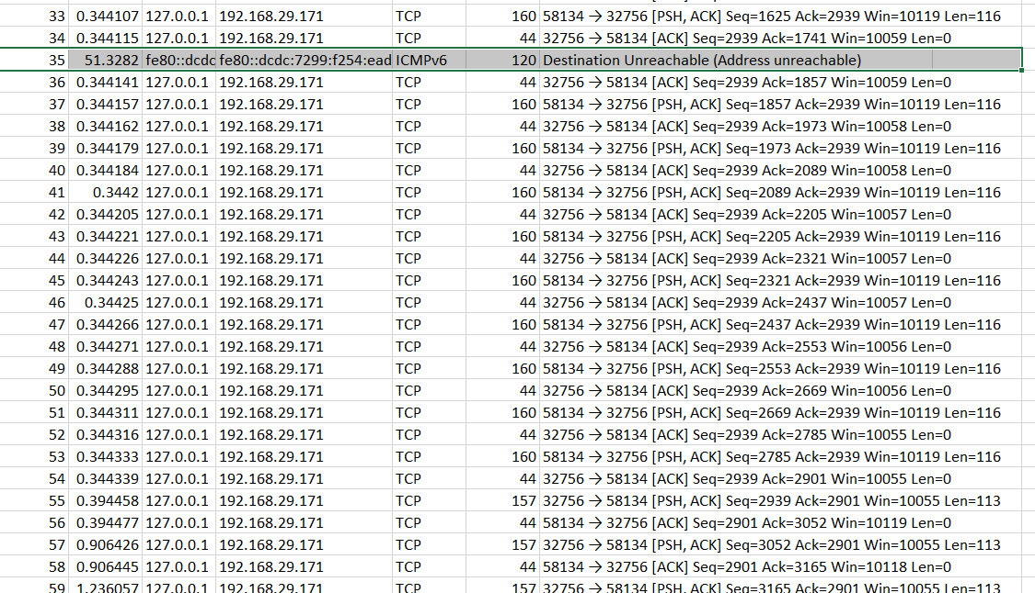
Final Output Detection of the DOS Attack:

